Slide 1
English Novel Summarization with Visualizations
2023.05.08
App-solutely Mobile
Fatemeh Pesaran Zadeh
Sehee Kim
Notes:
Hello, everyone, we are absolutely-mobile team.
The title of the project is image generation using text summarization

Slide 2
Contents
Summary of Project
Text Summarization
Visualization

Slide 3
Summary of Project

Slide 4
Summary of Project
Take stories as input and create illustrations of those stories as output
Approach:
Stories → Text Summarization → Text-to-Image Generation → Illustrations
In this presentation, we will cover the experiments we have done for the Text Summarization task and the Image Generation task

Slide 5
Text Summarization

Slide 6
Text Summarization
Envisioned Approach for Text Summarization
Select Model
Fine-tune Model
Make Appropriate Output for Image Generation

Slide 7
Select Model
Considered Models: Bart, T5
Bart
Used for pretraining sequence-to-sequence models[1]
Pre-trained dataset used for experiment: CNN/Daily Mail [2]
News articles
T5
Pre-trained dataset used for experiment: Colossal Clean Crawled Corpus[3]
English text from the web
[1]Lewis, Mike, et al. "Bart: Denoising sequence-to-sequence pre-training for natural language generation, translation, and comprehension." arXiv preprint arXiv:1910.13461 (2019).
[2]https://huggingface.co/facebook/bart-large-cnn
https://huggingface.co/datasets/cnn_dailymail
[3]Raffel, Colin, et al. "Exploring the limits of transfer learning with a unified text-to-text transformer." The Journal of Machine Learning Research 21.1 (2020): 5485-5551.
https://huggingface.co/datasets/c4

Slide 8
Select Model - Experiment
Dataset: BookSum
Dataset of texts from literatures, with summaries written by humans[1]
Quantitative Evaluation Metric: ROUGE
ROUGE-1, ROUGE-2, ROUGE-L
ROUGE-N uses ngrams, ROUGE-L uses the Longest Common Subsequence for evaluation.[2]
Qualitative Evaluation
Appropriate information selection, correct information, grammar
[1]Kryściński, Wojciech, et al. "Booksum: A collection of datasets for long-form narrative summarization." arXiv preprint arXiv:2105.08209 (2021).
[2]Lin, Chin-Yew. "Rouge: A package for automatic evaluation of summaries." Text summarization branches out. 2004.

Slide 9
Select Model - Quantitative Evaluation
Average ROUGE scores tested on the BookSum dataset’s training data
Bart
T5
 | ROUGE-1 | ROUGE-2 | ROUGE-L
Recall | 0.10119292006929159 | 0.010267753747128848 | 0.09339485870555357
Precision | 0.319718826849668 | 0.04880348930675858 | 0.2982834708088586
F1 score | 0.14300877941576004 | 0.01565856222885379 | 0.132424194513342
 | ROUGE-1 | ROUGE-2 | ROUGE-L
Recall | 0.0892965407983512 | 0.009368207574238847 | 0.08239038719193761
Precision | 0.32013575564391483 | 0.049448898234183976 | 0.297302526387105
F1 score | 0.1306423179829161 | 0.014637661535717652 | 0.12069257260777198
ROUGE Code Used: https://github.com/pltrdy/rouge (According to page, results may be slightly different from original ROUGE code)

Slide 10
Select Model - Quantitative Evaluation Analysis
ROUGE scores are on the lower side
Recall tends to be higher than Precision
This means that information that are not necessarily important enough to be included in a summary is included in the output.
Cannot say which model is better
Bart shows slightly better Recall, T5 shows slightly better Precision
Final decision will be made after fine-tuning

Slide 11
Select Model - Qualitative Evaluation
Original Text (Part of Pride and Prejudice Chapter 1)
Bart
It is a truth universally acknowledged, that a single man in possession of a good fortune, must be in want of a wife.
However little known the feelings or views of such a man may be
on his first entering a neighbourhood, this truth is so well fixed in the
minds of the surrounding families, that he is considered the rightful
property of some one or other of their daughters.
“My dear Mr. Bennet,” said his lady to him one day, “have you
heard that Netherfield Park is let at last?”
Mr. Bennet replied that he had not.
“But it is,” returned she; “for Mrs. Long has just been here, and she
told me all about it.”
Mr. Bennet made no answer.
“Do you not want to know who has taken it?” cried his wife impatiently.
“You want to tell me, and I have no objection to hearing it.”
This was invitation enough. (...continued)
'“Do you not want to know who has taken it?” cried his wife impatiently. “You want to tell me, and I have no objection to hearing it.”“Why, my dear, you must know, Mrs. Long says that Netherfield istaken by a young man of large fortune from the north of England”’
T5
'a single man in possession of a good fortune, must be in want ofa wife. this truth is so well fixed in the minds of the surrounding families, that he is considered the rightfulproperty of some one orother of their daughters. "my dear, my dear, do you not want to know who has taken it?” cried his wife impatiently.’
https://www.gutenberg.org/files/1342/old/pandp12p.pdf

Slide 12
Select Model - Qualitative Evaluation
Original Text(Part of BBC article)
Bart
The British public is refusing to let typical bank holiday weather spoil its Coronation plans and is gearing up for street parties and family celebrations.
Around £200m will be spent on food and drink this weekend, according to the Centre for Retail Research (CRR).
Supermarket chain Lidl said it had sold enough bunting to line the Coronation procession route 75 times over.
Party products and traditional British fayre are in high demand and brands are offering royal-themed ranges.
Overall the CRR expects consumers to add more than £1.4bn to the UK economy over the long weekend.
Tesco said it was on track to sell 675,000 pork pies and 300,000 pots of clotted cream.
(...omitted due to lack of space...)
Dozens of products from pork pies and golden syrup to gin and elderflower cordial have gone purple and gold or tweaked their branding to feature Buckingham Palace, crowns and bunting. Ikea is offering a coronation chicken flavour sauce on its famous meatballs.
Tesco's Maheen Piracha said shoppers were in a mood to celebrate: "Judging by early sales, King Charles' Coronation is set to spark a feel-good factor with plenty of street and house parties."
'Supermarket chain Lidl said it had sold enough bunting to line the Coronation procession route 75 times over. Tesco said it was on track to sell 675,000 pork pies and 300,000 pots of clotted cream. Around £200m will be spent on food and drink this weekend, according to Centre for Retail Research.’
T5
'around £200m will be spent on food and drink this weekend, according to the centre for retail research. supermarket chain Lidl said it had sold enough bunting to line the Coronation procession route 75 times over. Tesco said it was on track to sell 675,000 pork pies and 300,000 pots of clotted cream.’
https://www.bbc.com/news/business-65494210

Slide 13
Select Model - Qualitative Evaluation Analysis
No wrong information was included in both cases
Better results when input text is an article than when it is a novel(story)
Less grammatical errors
More information related to the central theme included in output text
The current models seem to have trouble with summarizing dialog.
In the novel summarization, there was no paraphrasing of dialog. They were brought to the output text without changes
In the article summarization, while there was little dialog, the output text did not include information from it.

Slide 14
Immediate Future Plan
Fine-tuning
Datasets: SAMSum Corpus, BookSum
SAMSum Corpus
Dataset with abstractive dialog summaries[1]
For better dialog summarization
BookSum
Adjust the models to summarizing story format text
[1]Gliwa, Bogdan, et al. "SAMSum corpus: A human-annotated dialogue dataset for abstractive summarization." arXiv preprint arXiv:1911.12237 (2019).

Slide 15
Visualization

Slide 16
Visualizations
Approached solution:
Using Prompt-to-Prompt Image Editing with Cross Attention Control, Hertz et al., 2022 paper.

Slide 17
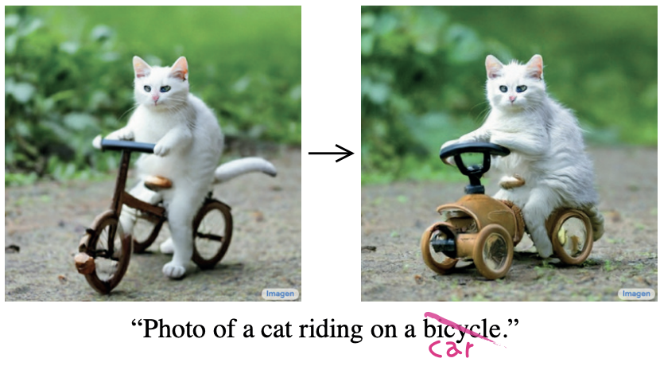
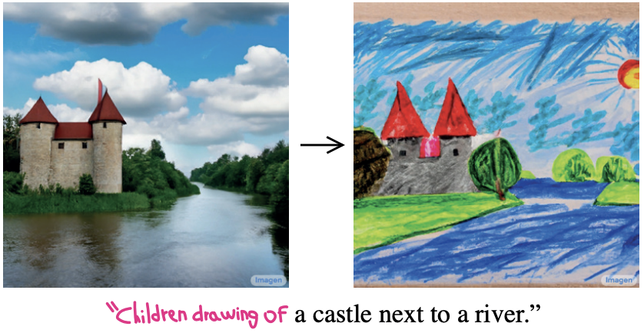
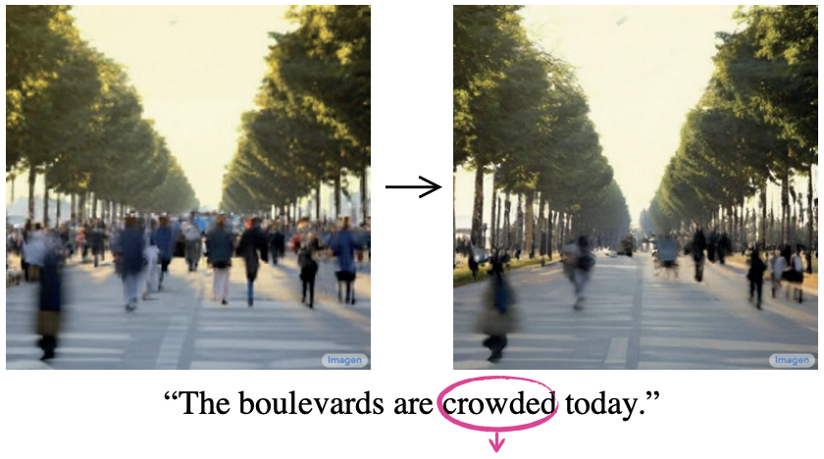
Introduction
Change a single token’s value in the prompt, while fixing the the cross-attention maps, to preserve the scene composition.
Change the style by adding new words to the prompt and freezing the attention on previous tokens, while allowing new attention to flow to the new tokens.
Amplify the semantic effect of a word in the generated image.

Slide 18
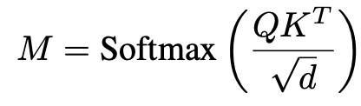
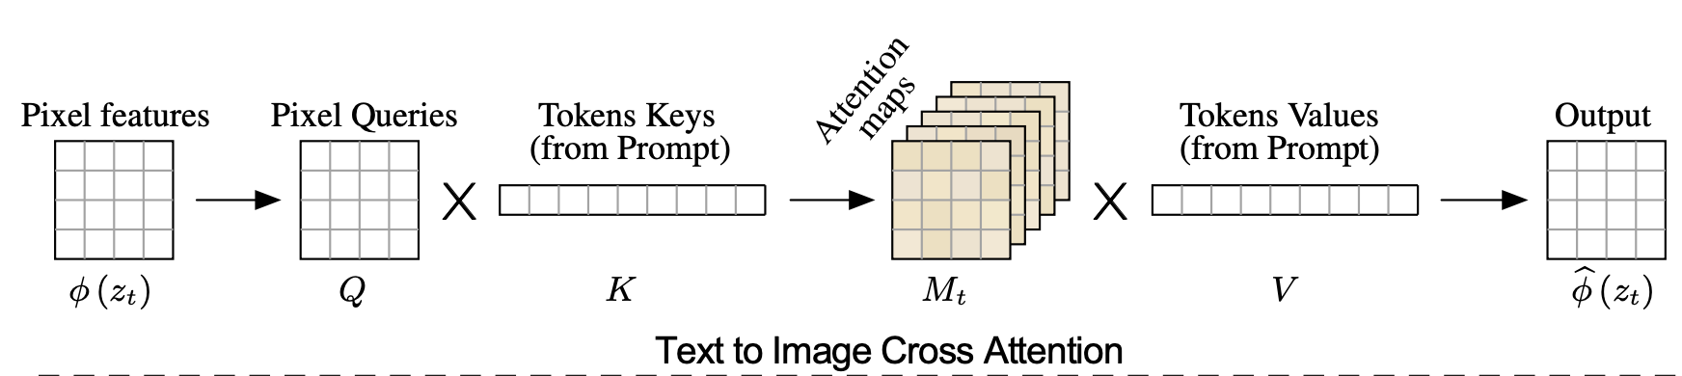
Method
The deep spatial features of the noisy image φ(zt) are projected to a query matrix Q = `Q(φ(zt)), and the textual embedding is projected to a key matrix K = `K(ψ(P)) and a value matrix V = `V (ψ(P)), via learned linear projections `Q, `K, `V . The attention maps are:
Cell Mij defines the weight of the value of the j-th token on the pixel i.
d is the latent projection dimension of the keys and queries.

Slide 19
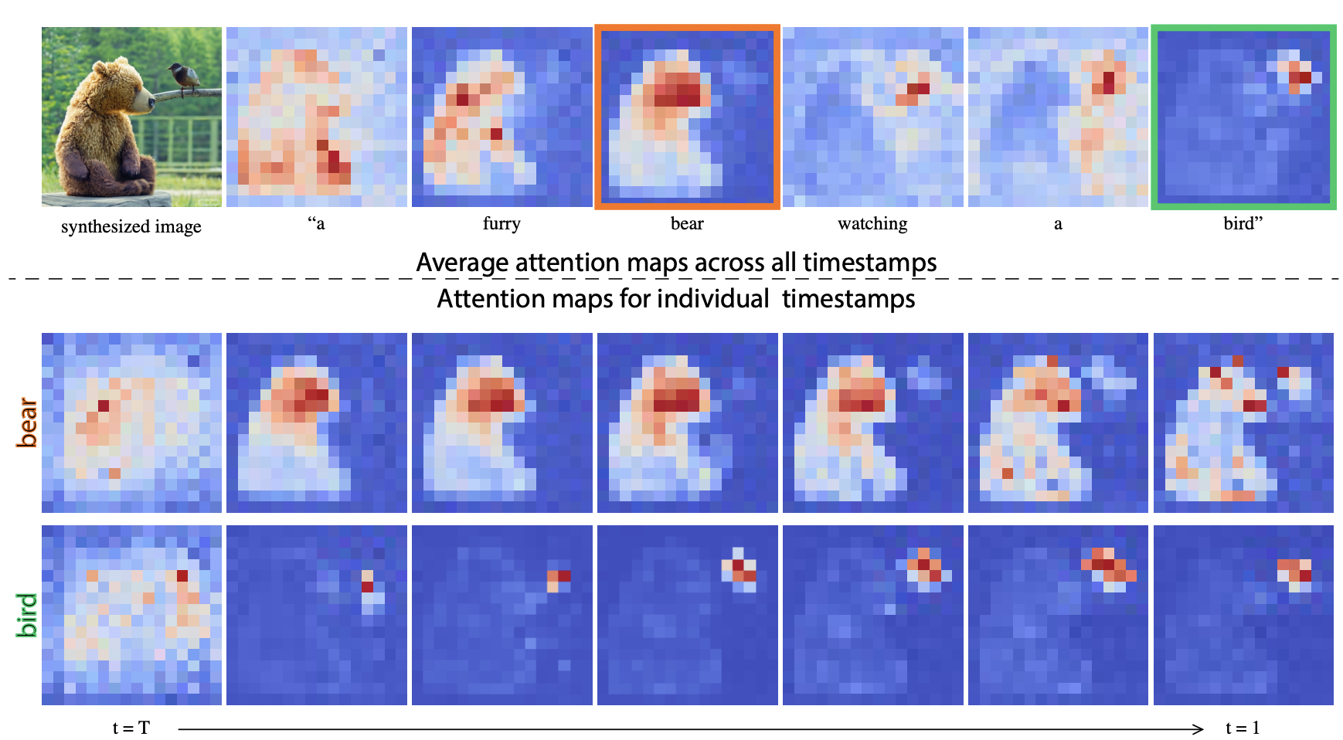
Cross-attention maps of a text-conditioned diffusion image generation

Slide 20
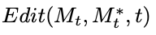
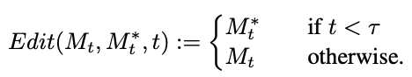
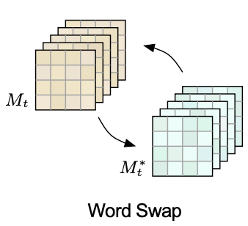
Controlling the Cross-Attention
Specific editing operations:
Word Swap
Adding a New Phrase
Attention Re-weighting
Word Swap: In this case, the user swaps tokens of the original prompt with others.

Slide 21
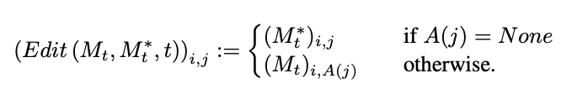
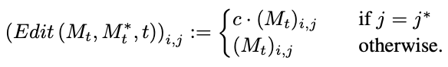
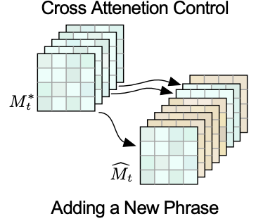
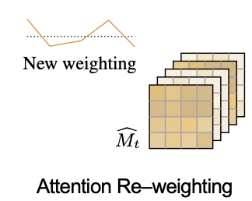
Controlling the Cross-Attention
Adding a new phrase:
The user adds new tokens to the prompt.
Attention Re-weighting:
user wants to strengthen or weakens the extent to which each token is affecting the resulting image.

Slide 22
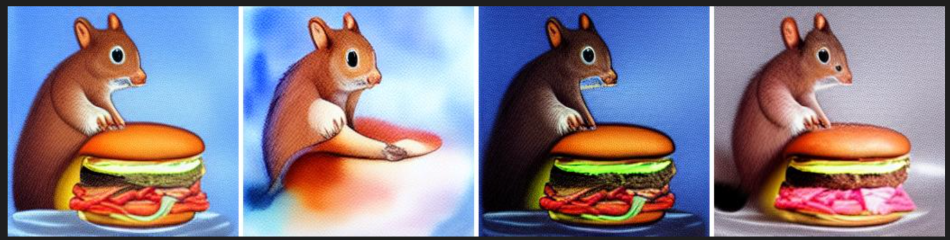
Output Example:
Prompts[ “A painting of a squirrel eating a burger”,
“A watercolor painting of a squirrel”,
“A dark painting of a squirrel eating a green burger”,
“A realistic photo of a squirrel eating a pink burger”]

Slide 23
Challenges:
Finding the right prompts are going to be challenging. Also how to edit the original prompt to have the best edited image is tricky.
This model has been trained on the limited dataset.
This model editing options are limited. Current model cannot be used to spatially move existing objects across the image.

Slide 24
Thank you for listening!

